Slide 1
Apache Kafka
Overview Session

Slide 2
Agenda
Pub/Sub Messaging
Apache Kafka Concepts
Apache Kafka Use cases
Apache Kafka Broker and Zookeeper
Kafka Producer implementation in Java
Kafka Producer Configurations
Kafka Consumer implementation in Java
Kafka Consumer Configurations
Q&A

Slide 3
Pub/Sub messaging
Frontend server
Frontend server
Database server
Backend server
Publisher classifies the message somehow and not directs it to specific consumer. The subscribers/consumers read the messages which they need.
Pub/Sub systems often have a broker, a central point where messages are published, to facilitate this pattern.
A filesystem or database commit log is designed to provide a durable record of all transactions so that they can be replayed to consistently build the state of a system
Metrics pub/sub
Metrics UI
Database monitor
Metrics analysis

Slide 4
Apache Kafka
Apache Kafka is a distributed streaming platform (originally developed by LinkedIn)
Important capabilities:
Publish and subscribe to streams of records, like a message queue or enterprise messaging system.
Store streams of records in a fault-tolerant durable way.
Process streams of records as they occur.
Kafka is run as a cluster on one or more servers that can span multiple datacenters.
The Kafka cluster stores streams of records in categories called topics.
Each record consists of a key (optional), a value, and a timestamp.

Slide 5
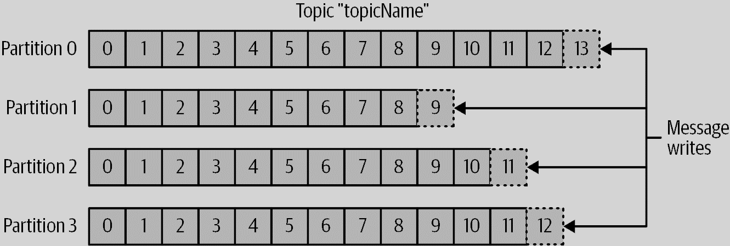
Topic
Messages in Kafka are categorized into topics.
Topics are additionally broken down into several partitions.
There is no guarantee of message ordering across the entire topic, just within a single partition

Slide 6
Partitions
Partitions are also the way that Kafka provides redundancy and scalability
Each partition can be hosted on a different server, which means that a single topic can be scaled horizontally across multiple servers
Partitions can be replicated; such that different servers will store a copy of the same partition in case one server fails.
Messages are ordered across partition if the messages have keys, if the number of partitions does not change.

Slide 7
Producers/Consumers
Kafka clients are users of the system, and there are two basic types: producers and consumers.
Producers create new messages. A message will be produced to a specific topic.
By default, the producer will balance messages over all partitions of a topic evenly.
All messages produced with a given key will get written to the same partition.
The consumer subscribes to one or more topics and reads the messages in the order in which they were produced to each partition.

Slide 8
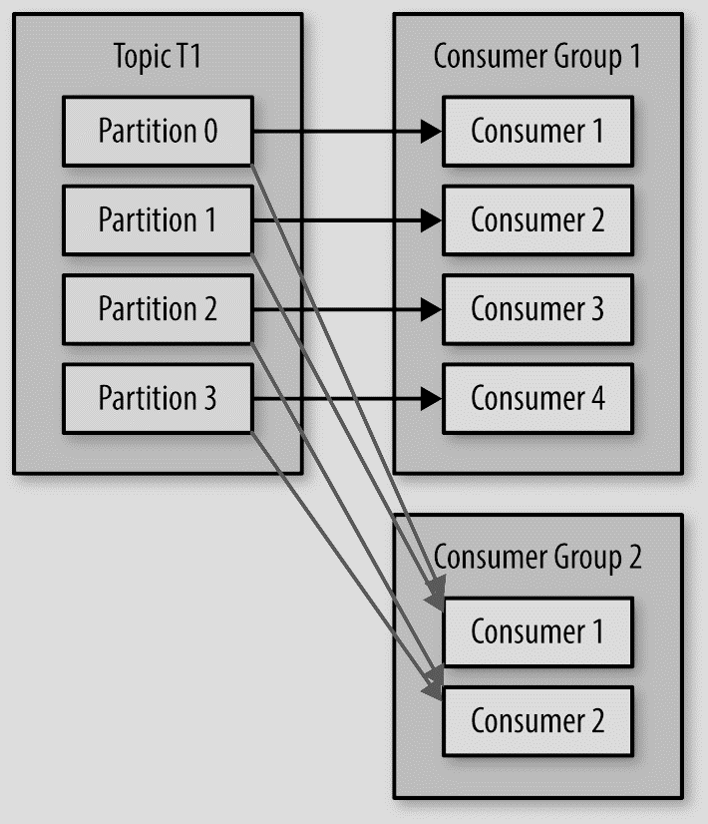
Consumer group
Consumers work as part of a consumer group, which is one or more consumers that work together to consume a topic. The group ensures that each partition is only consumed by one member.
Each message in the topic is consumed by only one consumer within consumer group.
Any consumer within a consumer group can read from zero, one or more partition but no two consumers can read from same partition in a consumer group.
Different consumer groups get all messages of the topics
If the number of consumers is more than number of partitions, extra consumers remain idle

Slide 9
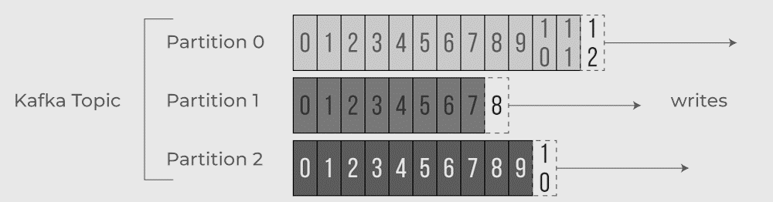
Offsets
The consumer keeps track of which messages it has already consumed by keeping track of the offset of messages.
The offset—an integer value that continually increases is another piece of metadata that Kafka adds to each message as it is produced.
By storing the next possible offset for each partition, typically in Kafka itself, a consumer can stop and restart without losing its place.

Slide 10
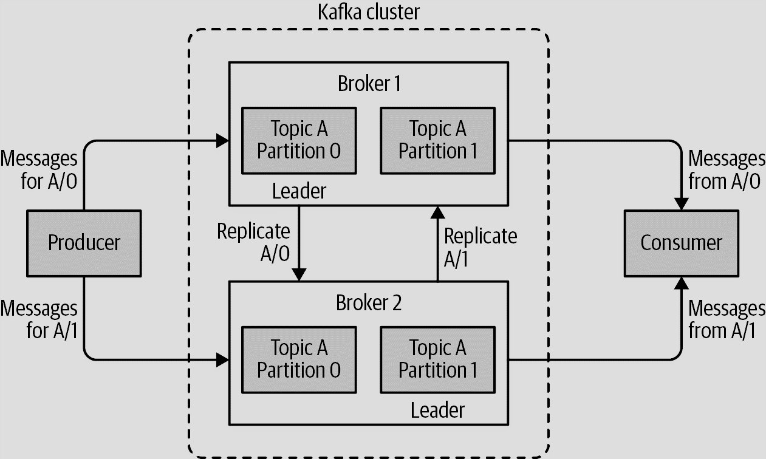
Replication
Replication factor : Topic configuration to decide number of replicas of the partition.
Each broker in the cluster can have one replica. Replication factor cannot be more than number of brokers in cluster.
One replica serves as leader and others are followers
Replication factor of N allows us to lose N-1 brokers while still being able to read and write data to the topic
If a topic has three replicas and we set min.insync.replicas to 2, then producers can only write to a partition in the topic if at least two out of the three replicas are in sync.

Slide 11
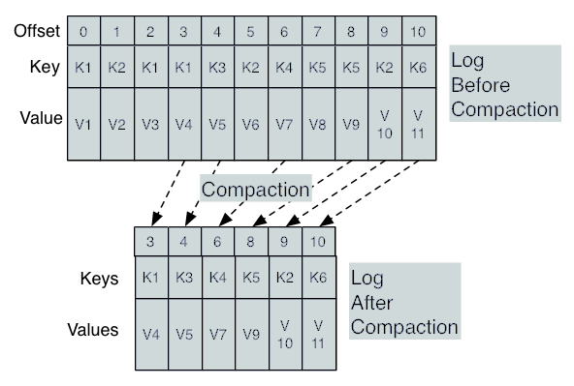
Log compaction
Topics can optionally be configured as log compacted.
Kafka will retain only the last message produced with a specific key.
Useful for changelog-type data, where only the last update is interesting. E.g. Account balance, DB state, Cache

Slide 12
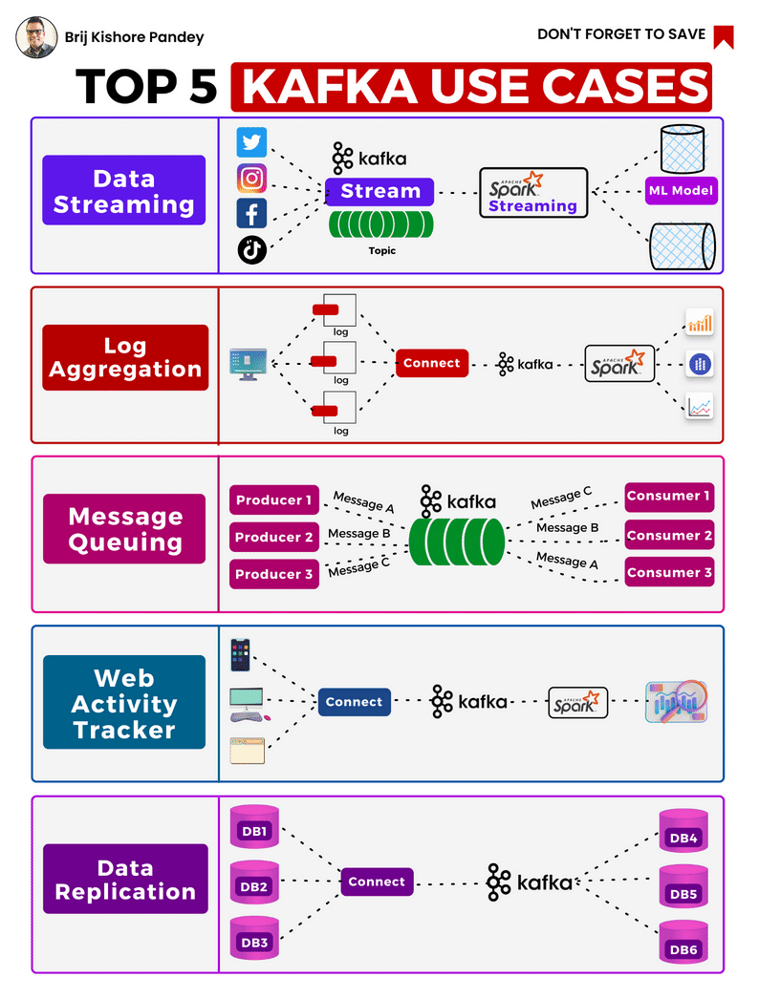
Kafka common use cases
https://kafka.apache.org/powered-by

Slide 13
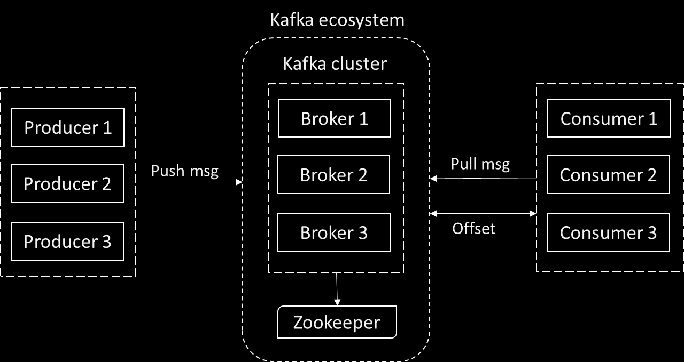
Kafka cluster

Slide 14
Broker
A single Kafka server is called a broker. Each broker has a numeric id.
The broker receives messages from producers, assigns offsets to them, and writes the messages to storage on disk.
It also services consumers, responding to fetch requests for partitions and responding with the messages that have been published.
Depending on the specific hardware and its performance characteristics, a single broker can easily handle thousands of partitions and millions of messages per second.
Kafka brokers are designed to operate as part of a cluster

Slide 15
Cluster
Within a cluster of brokers, one broker will also function as the cluster controller (elected automatically from the live members of the cluster).
The controller is responsible for administrative operations, including assigning partitions to brokers and monitoring for broker failures.
A partition is owned by a single broker in the cluster, and that broker is called the leader of the partition. Replicated partition is assigned to additional brokers, called followers of the partition
All producers must connect to the leader to publish messages, but consumers may fetch from either the leader or one of the followers.

Slide 16
Zookeeper
Apache Kafka uses Apache Zookeeper to store metadata about the Kafka cluster, as well as consumer client details.
Zookeeper is a centralized service for maintaining configuration information, naming, providing distributed synchronization, and providing group services.
Zookeeper is designed to work as a cluster, called an ensemble, to ensure high availability.
Due to the balancing algorithm used, it is recommended that ensembles contain an odd number of servers (e.g., 3, 5, and so on) as a majority of ensemble members (a quorum) must be working for Zookeeper to respond to requests.
Zookeeper keeps track of which brokers are part of the Kafka cluster. Zookeeper is used by Kafka brokers to determine which broker is the leader of a given partition and topic and perform leader elections.

Slide 17
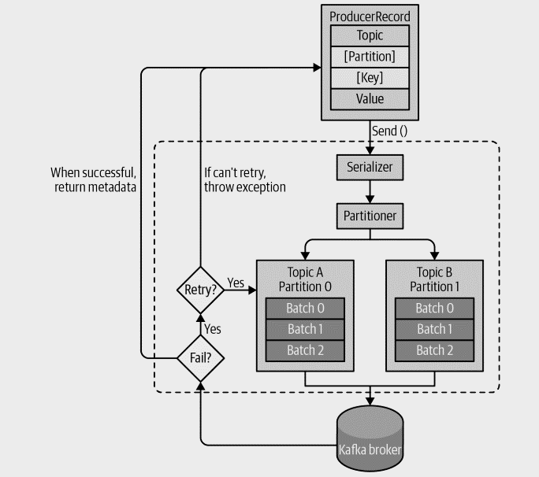
Kafka Producer
Text

Slide 18
Let’s engage!

